Slide 1
Legal Aid Heatmaps
James Ness

Slide 2
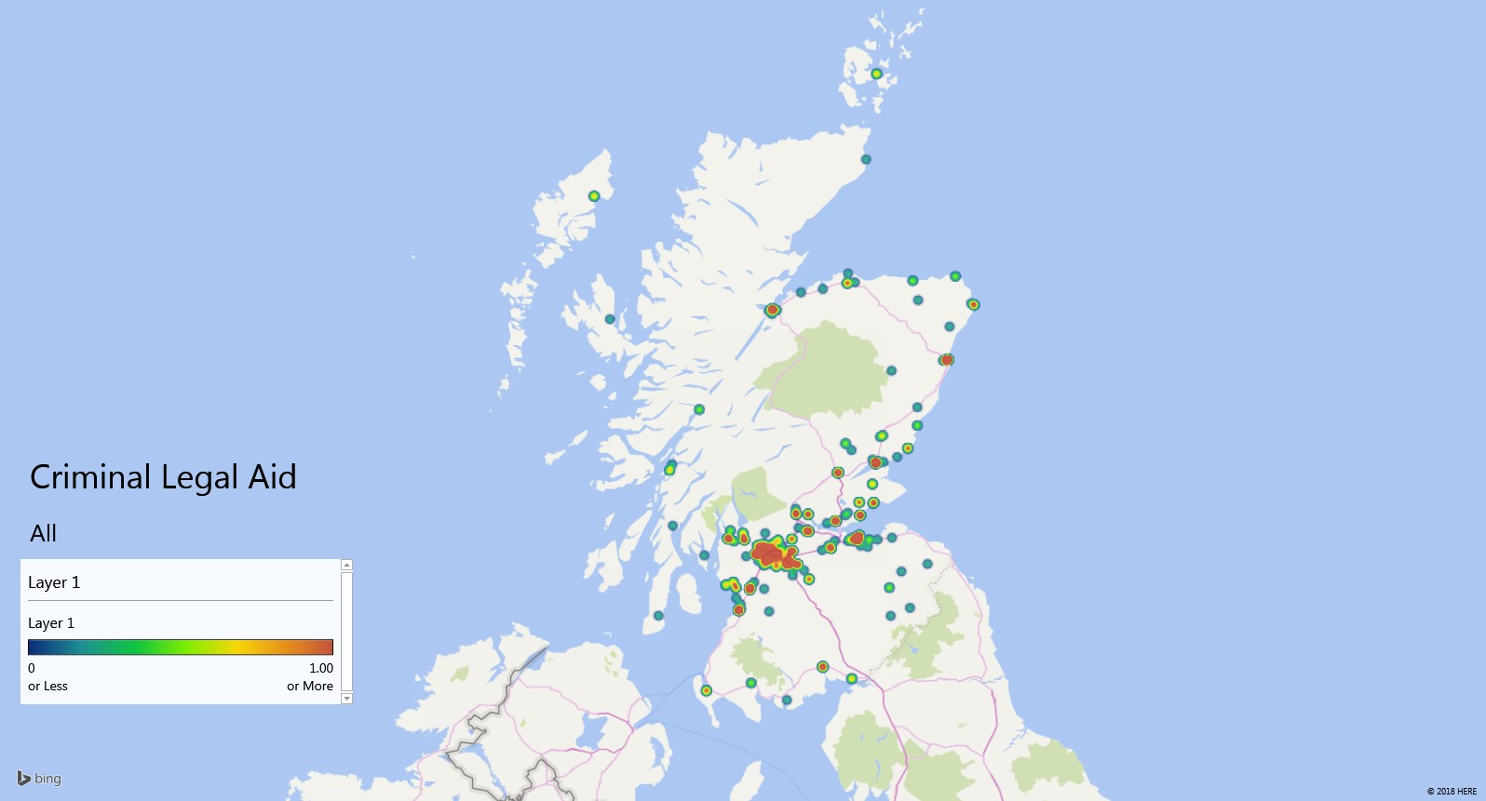
Legal Aid Heatmaps

Slide 3
Legal Aid Heatmaps

Slide 4
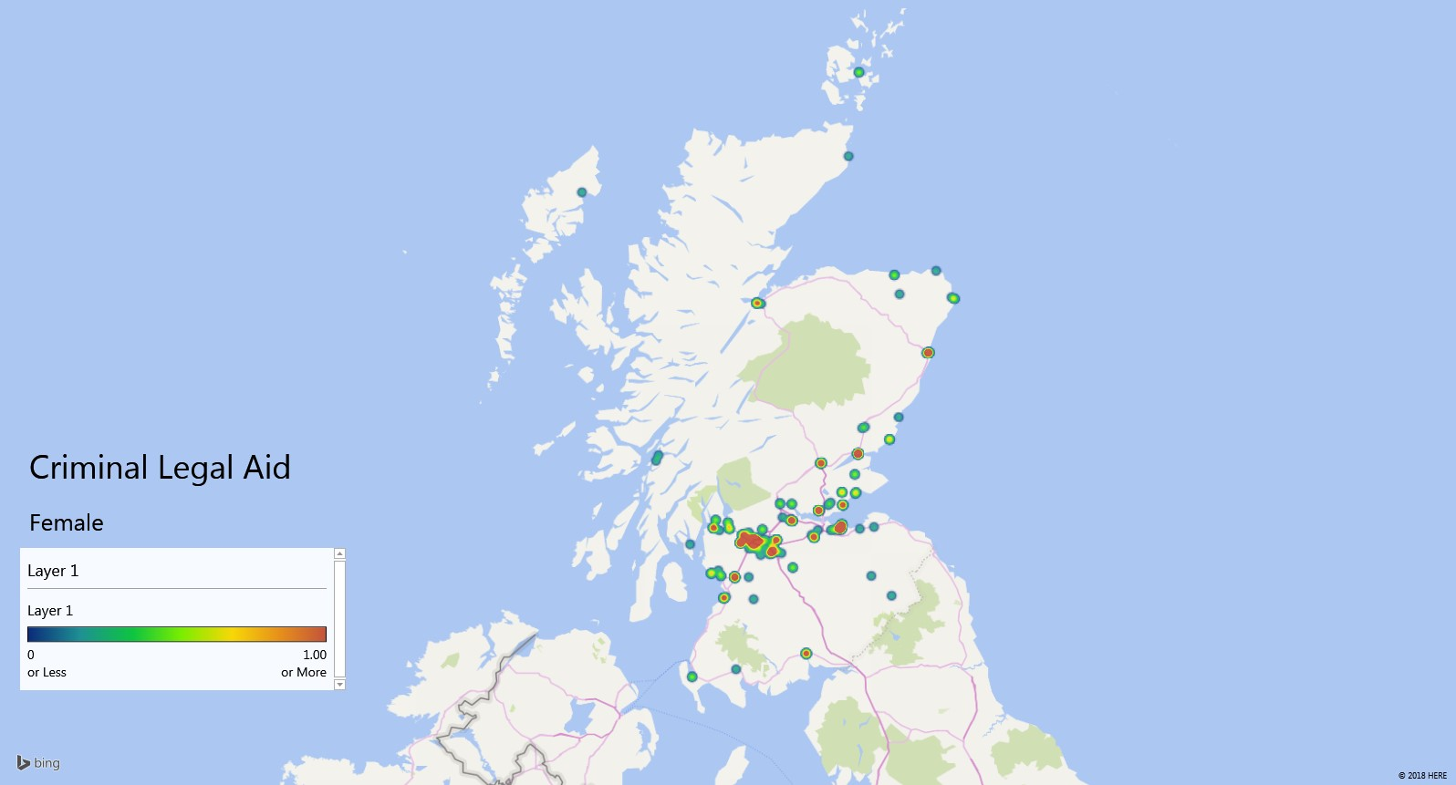
Legal Aid Heatmaps

Slide 5
Legal Aid Heatmaps

Slide 6
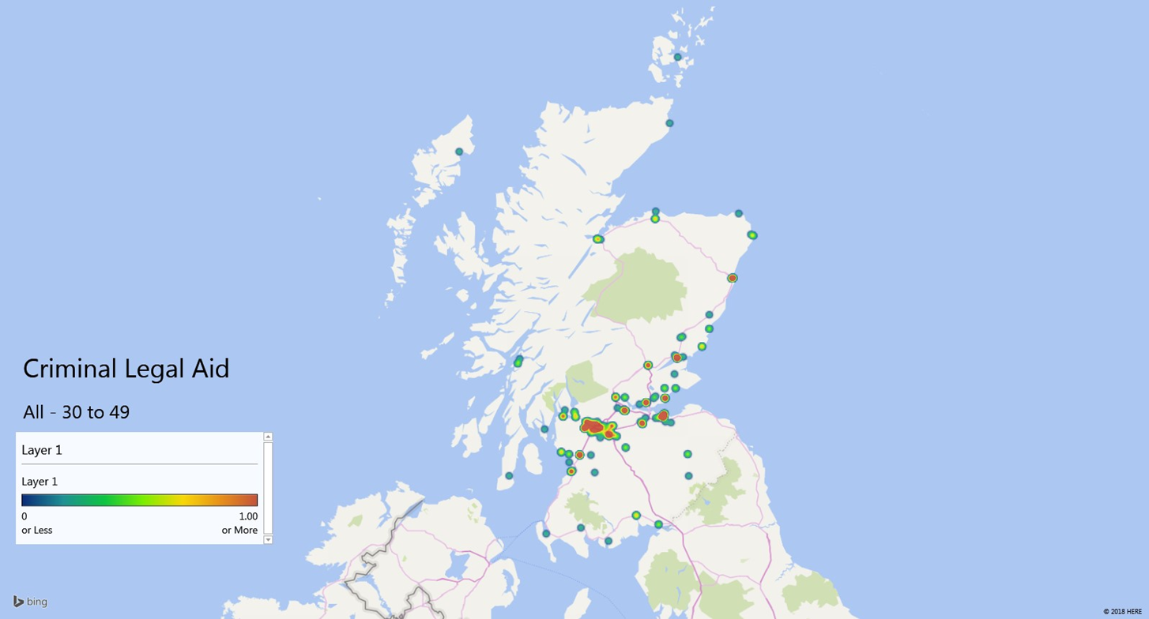
Legal Aid Heatmaps

Slide 7
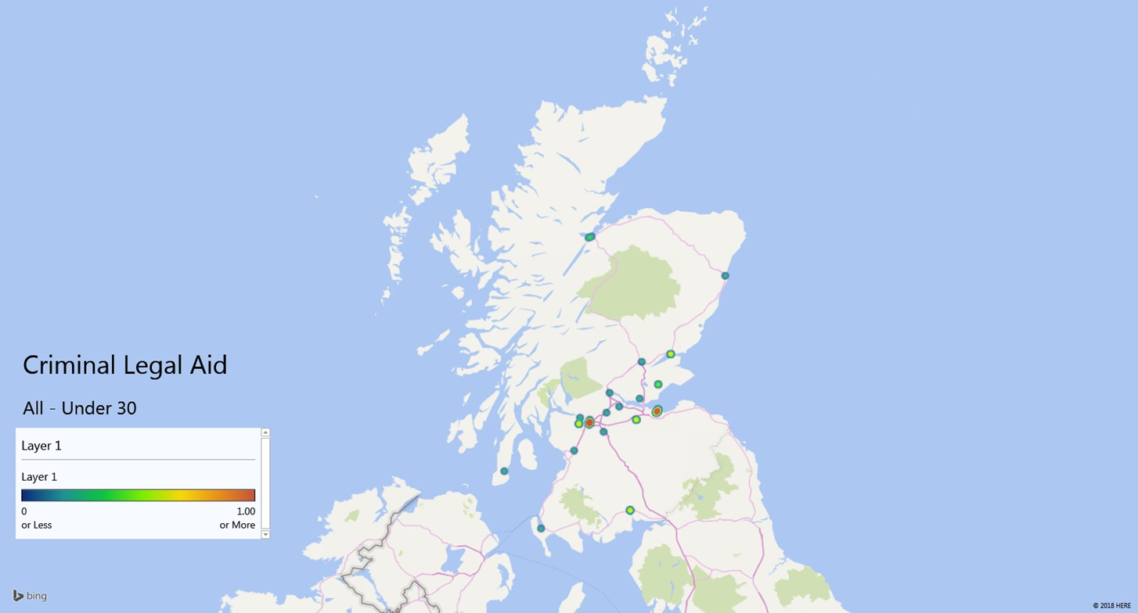
Legal Aid Heatmaps

Slide 8
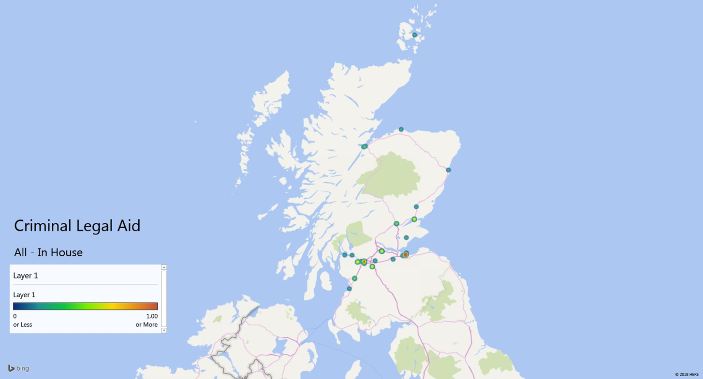
Legal Aid Heatmaps

Slide 9
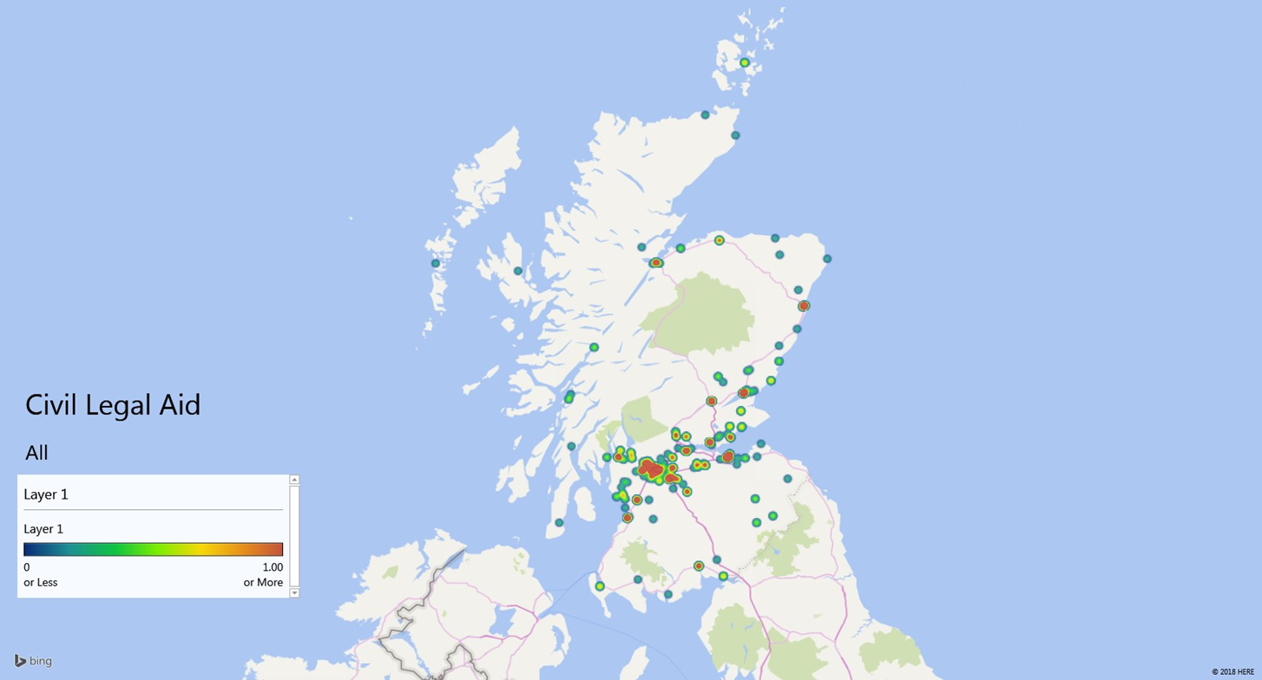
Legal Aid Heatmaps

Slide 10
Legal Aid Heatmaps

Slide 11
Legal Aid Heatmaps

Slide 12
Legal Aid Heatmaps

